Slide 1

Expanding Energy Access by Scaling Up Energy Efficiency in Sub-Saharan Africa
Emmanuel Kofi Ackom, PhD
Senior Scientist & GNESD Manager
UNEP DTU Partnership
Energy Efficient Prosperity
IEA Energy Efficiency in Emerging Economies COP21 Side Event, Paris, France, 1st December 2015

Slide 2
Outline
  Establishing the link between Energy Access & Prosperity
  Current situation of Energy Access in SSA & Outlook
  Energy Efficiency in SSA: Activities & outcomes
    Country case study
  Required Investments: Energy Access & Energy Efficiency
  Concluding Recommendations
UN City, Copenhagen

Slide 3
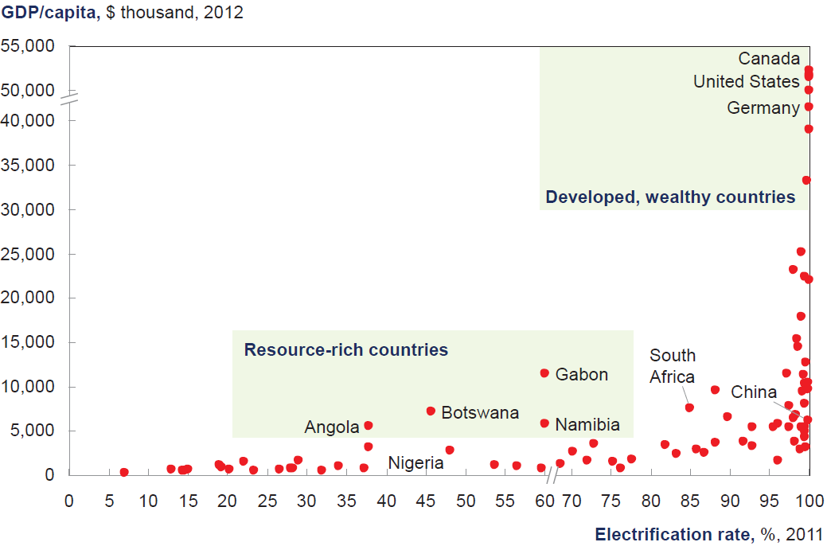
Relationship between Energy Access & Prosperity
Electricity Access Database, IEA WEO, 2013; McKinsey, 2015

Slide 4
Energy Resource Potential in SSA
TWh
600
West
TWh
300
East
500
250
400
200
300
150
200
100
100
50
2000
2020
2040
2000
2020
2040
TWh
150
Central
TWh
1 000
Southern
120
800
90
600
60
Other
renewables
Nuclear
400
30
Gas
200
Solar PV
Oil
Hydro
Coal
2000
2020
2040
2000
2020
2040
Source: IEA WEO 2014

Slide 5

Reversing the current '66% situation' of Energy Access & Investments in SSA
66% of SSA population have no access to electricity
66% of energy investment in SSA is for export rather than internal utilization
Average annual investment in
SSA energy supply
$Billion
(2013)
120
100
For export
80
⅔
For SSA use:
60
⅓
Fuels
40
Electricity
20
⅔
⅓
World Bank 2011
2000-2013
2014-2040
IEA WEO 2014

Slide 6
High Electricity Tariff – barrier & (opportunity?)
Obsolete and/or inefficient power generation facilities (GNESD 2009)
High Transmission & Distribution (T&D) losses are among key factors for the high tariffs in SSA.
Losses as share of total generation in W. Africa
Losses transferred to
consumers
Current Tariff:
$130 – 140 /MWh
Year 2030:
$70 /MWh
Year 2040:
$60 /MWh
IEA 2014, McKinsey, 2015
%
ECREEE, 2014
A barrier to increased Energy Access.
Opportunity to educate & promote energy efficient behaviour/attitude

Slide 7
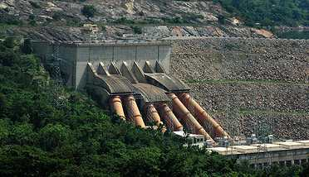
Jobs & Economic Benefits form Energy Access
Estimated ~ 2.5 million jobs (direct) by 2040 for achieving 70% Energy Access in SSA (McKinsey, 2015)
  1.9 million construction of power plants (temporal but skills can be transferred to other construction or related industries afterwards)
  300,000 – 450, 0000 day-to-day operation and maintenance of the generation, transmission & distribution management
  Increased jobs in the supply industries i.e. cement industry
Indirect: value chain e.g. pipelines, rails etc)
Additionally, every $1 invested in Energy Access yields >$15 in incremental GDP (IEA WEO, 2014)
The Akosombo Dam
Source: www.travel-to-discover-ghana.com

Slide 8
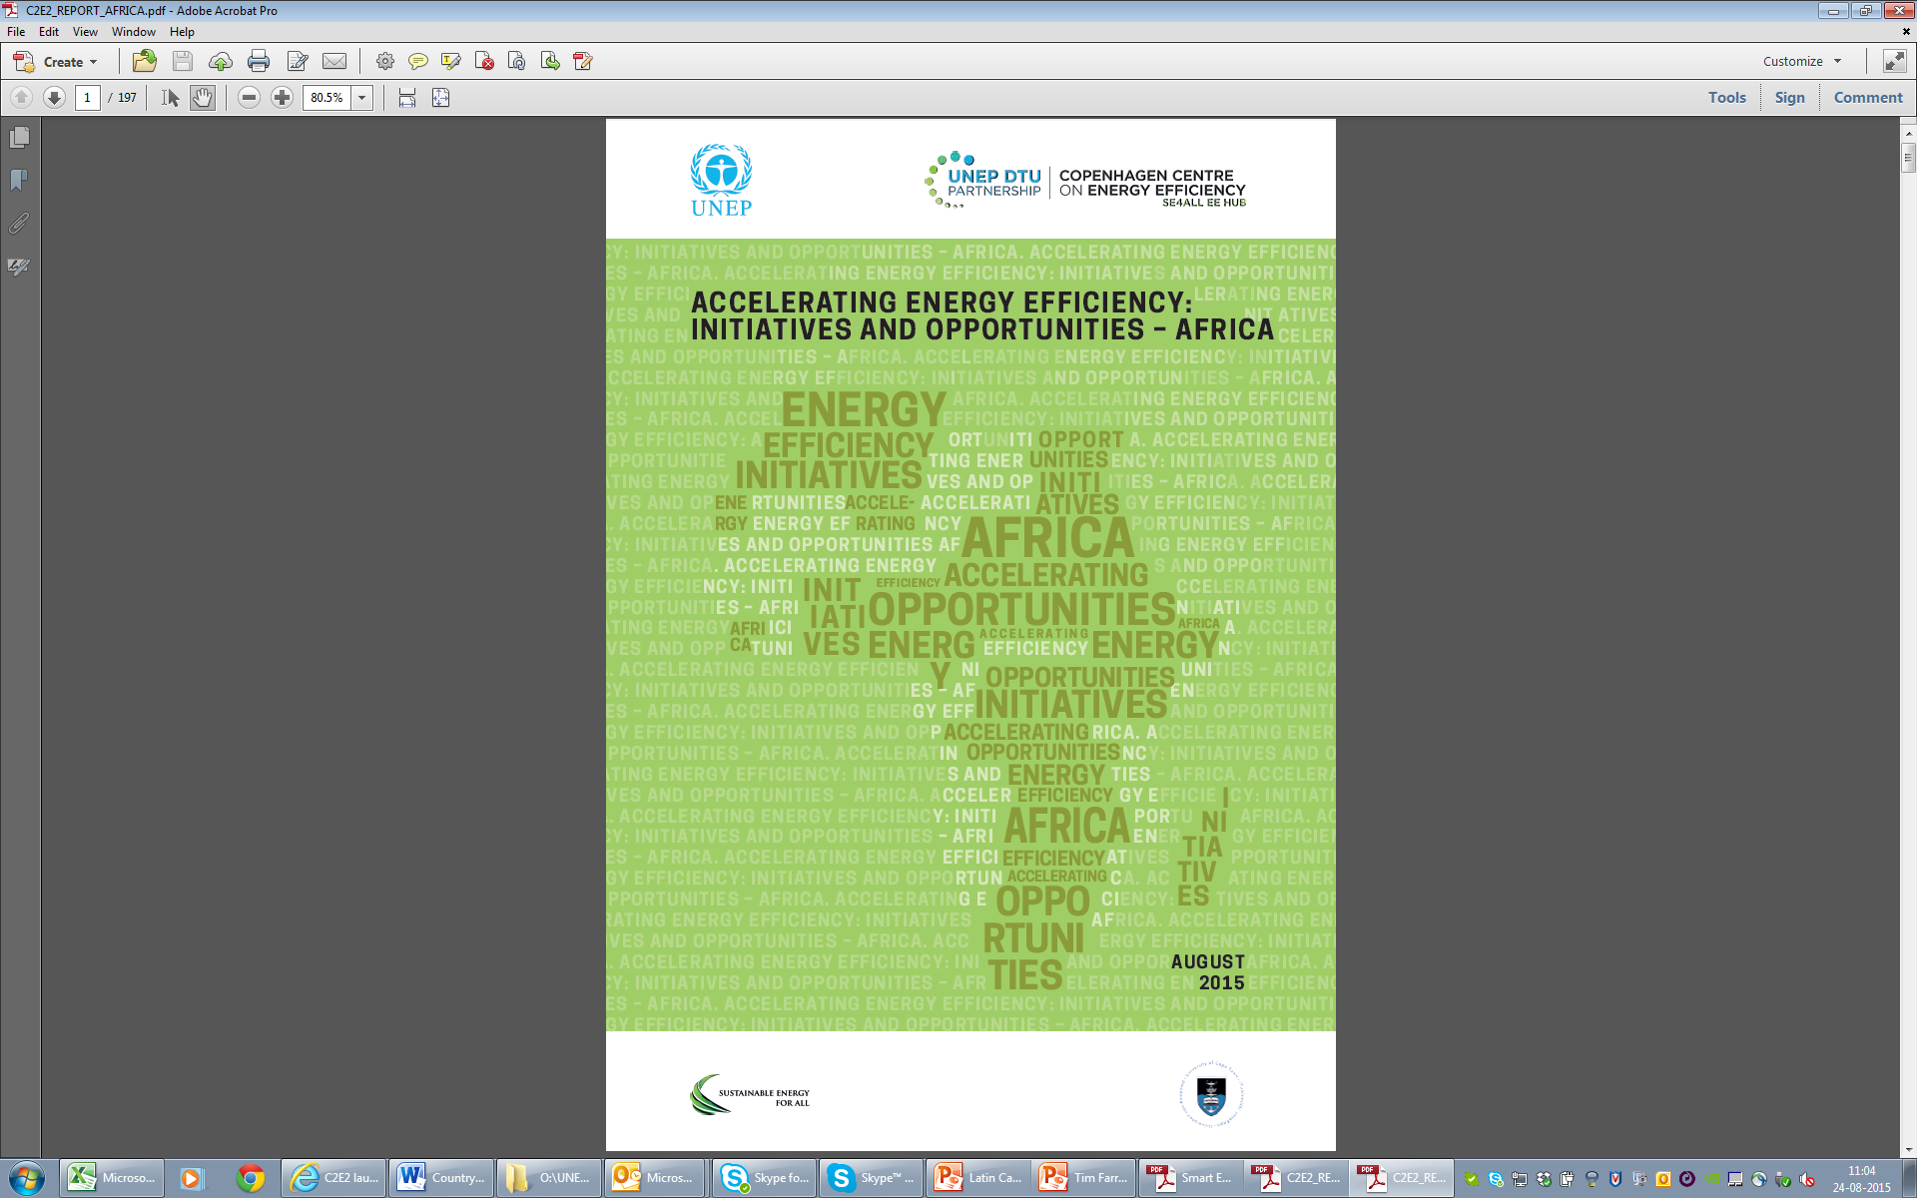
Copenhagen Centre on Energy Efficiency (C2E2)
Copenhagen Centre on Energy Efficiency (C2E2)
Energy Efficiency hub for SE4All
Global Energy Efficiency Accelerator Platform for SE4All
Activities in SSA
Provide technical support to Uganda, Zambia and Tanzania with Cape Town University as regional experts
Support African Development Bank work on SE4ALL Action Agendas and IPs
2015 report on energy efficiency opportunities in Africa
http://www.energyefficiencycentre.org/Publications

Slide 9
EE Activities in SSA
(excerpts from C2E2, 2015 study)
 | National EE Strategy | S&L | Mass Rollouts of Technology | Legisl-ation | Subsidized Energy Audits | Financing & soft loan schemes | Awareness & Promotion
Botswana | √ |  |  |  |  | √
Cameroon | √
Chad | √
Ethiopia | √
Ghana |  | √ | √ | √ |  |  | √
Kenya |  |  |  |  | √ | √ | √
Lesotho | √
Malawi | √ | √
Mauritius | √ | √ | √ |  |  |  | √
Nigeria |  |  | √
Rwanda |  |  | √
Sierra Leone | √
South Africa | √ | √ | √ |  | √ | √
Sudan | √
Zambia | √ |  | √ |  | √ |  | √
Zimbabwe |  |  | √

Slide 10
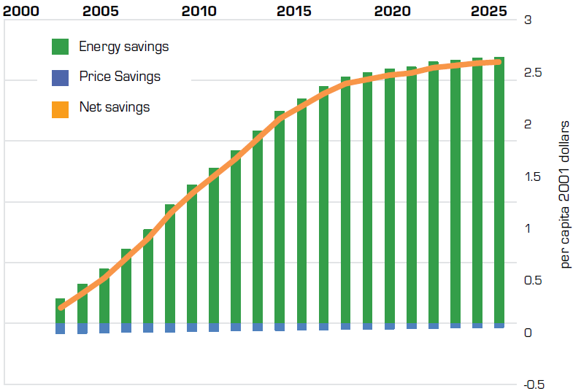
Country Example:
Energy & cost savings, Ghana
Ghana's room air conditioners
Estimated cost savings/year for Ghana
Room air conditioners – 30 mill. USD
Refrigerators – 72 mill. USD
CFLs – 39.5 mill. USD
Additionally, 100 Jobs (2 CFL factories)
775 mill. USD by 2020 (est.)
Source: CLASP 2015; Agyarko, 2014
Strong political will & target setting was a key driver

Slide 11
Investment (US $ cummulative)
 | Global |  | SSA
 | Now | Year 2040 | Year 2040
Energy Supply & Access | 1.6 trillion | 24 trillion | 835 - 958 billion (for >70% energy access)
Energy Efficiency | 130 – 310 billion | 5-8 trillion | 25 – 29 billion
McKinsey 2015; IEA WEO 2014; IEA Energy Efficiency Market Report 2014;
$40 billion in Energy Access capital savings from regionalization
& power pooling (McKinsey, 2015)

Slide 12
Concluding Recommendations
Strong political will and target setting will drive Energy Access & Energy Efficiency goals
Increased access to finance (domestic, private, international)
Reversing the 66% situation
Increased regional integration and power pooling
Identification and mitigation of losses
Productive uses and enterprise development from energy access, to create wealth and reduce poverty
Energy efficiency should be considered as important energy RESOURCE and not an 'add-on'
Energy efficiency has potential to enhance energy access (i.e. reliability, expansion), save money and create jobs

Slide 13
Thank you
'It always seems impossible until it’s done'
– Nelson Mandela
Global Network on Energy for Sustainable Development (GNESD)
Emmanuel Kofi Ackom
Email: emac@dtu.dk

