Slide 1
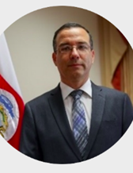
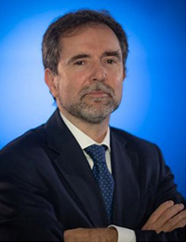
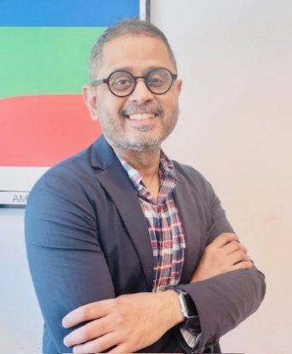
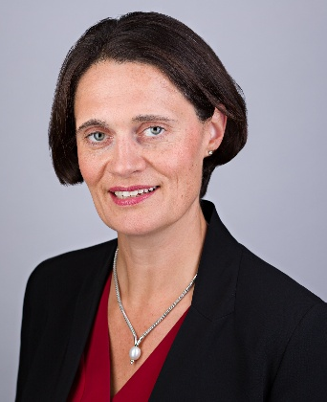
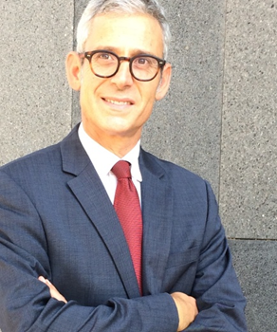
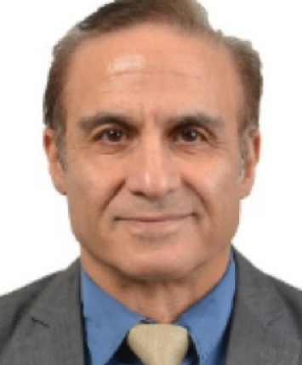
15 November 2025
10:00 – 11:15
Enhancing Energy Security through Disaster-Resilient Infrastructure
Special Remarks
Opening Remarks
Panel Discussion
Arghya Sinha Roy
Amy Barnes
Paolo Frankl
Director, Climate Change, Asian Development Bank
Head of Energy & Power and Climate & Sustainability Strategy, Marsh McLennan
Head of the Renewable Energy Division, IEA
Ramesh Subramaniam
Yves-Laurent
Sapoval
Amir H. Delju
Ronny Rodríguez Chaves
Senior Scientific Officer, Climate Services Branch, World Meteorological Organization
Global Director, Programmes & Strategy, CDRI
Vice Minister for Energy, Ministry of Environment and Energy of Costa Rica
Ministerial Delegate for Sustainable Cities,
Urban Envoy, France
We will explore global strategies to strengthen the link between energy security and disaster-resilient infrastructure in the context of a changing climate.

